Slide 1
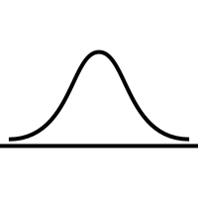
An Introduction to Morphometrics in R
22 June 2022
Daniel Koenemann
Daniel.Koenemann@ProtonMail.com
Notes:
Remember the show the code
Shoot for 45-50 mins so there is time for questions

Slide 2

An Introduction to Morphometrics in R
Ph.D. 2021: Howard University
Systematics – Phylogenetics and Taxonomy
Polygonaceae: Rumex, Triplaris, Coccoloba
Sex chromosome evolution in Rumex (Polygonaceae)
Postdoctoral Fellow NMNH
Logan Kistler (Anthropology)
Postdoctoral Research Associate Howard
Janelle Burke (Biology)

Slide 3
Cleaning and Prepping Data
Factors
Outliers
Missing Data

Slide 4
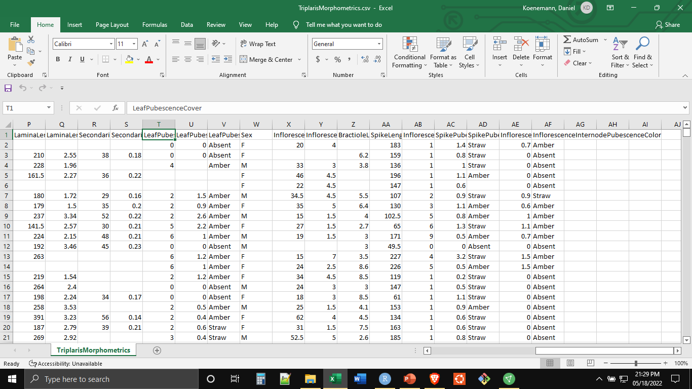
An Introduction to Morphometrics in R
Factors
Factors are Categorical Data, Which R Treats Differently than Numeric or String Data
Notes:
What are factors and why do we care

Slide 5
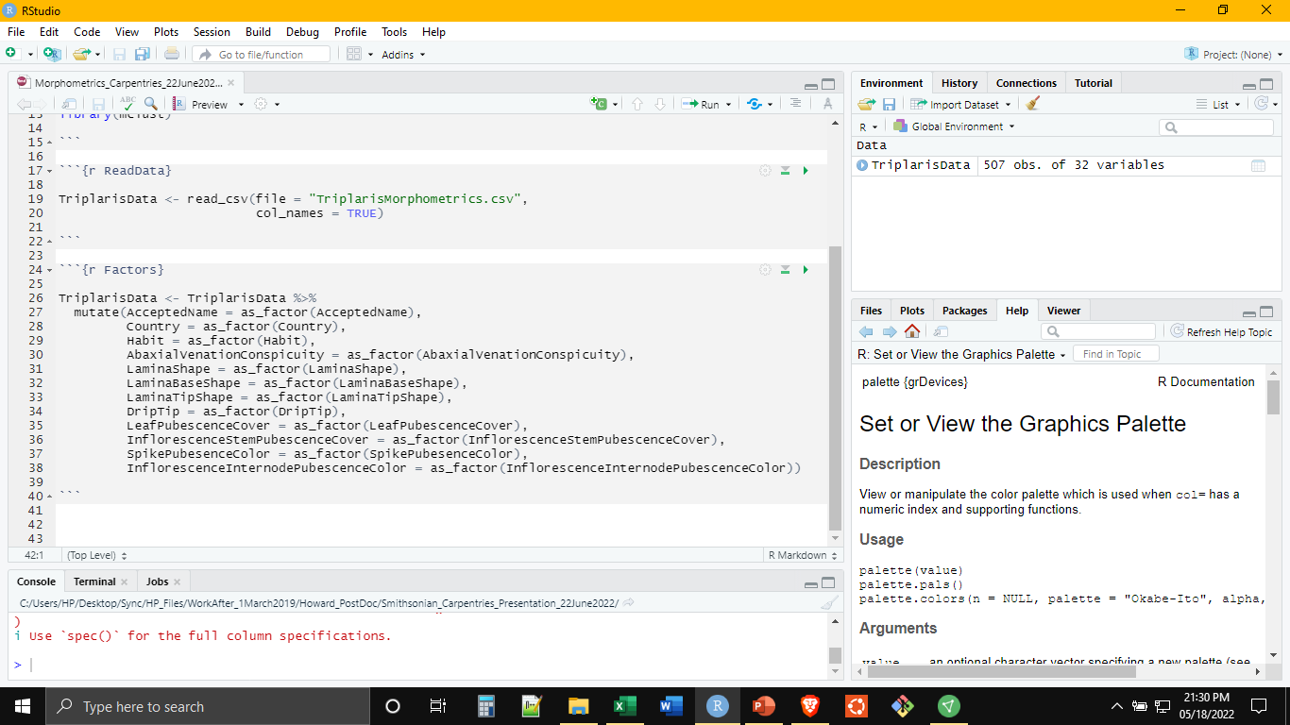
An Introduction to Morphometrics in R
Factors
Next, Read the Data with read_csv() (tidyverse: readr)
mutate() and as_factor() Allow for the Manipulation of Vectors (Columns) (tidyverse: dplyr, forcats)
Notes:
Mutate, what is it and what is the basic syntax
As_factor()
Can also force as_numeric if R is confused at all

Slide 6
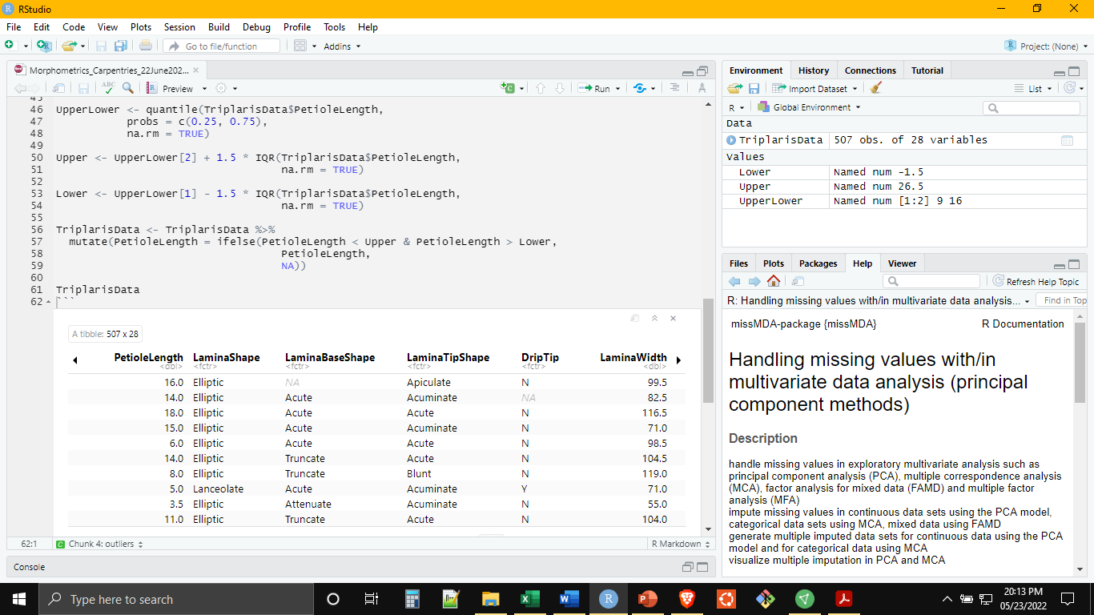
An Introduction to Morphometrics in R
Outliers
Mutate Can Help With Outliers as Well

Slide 7
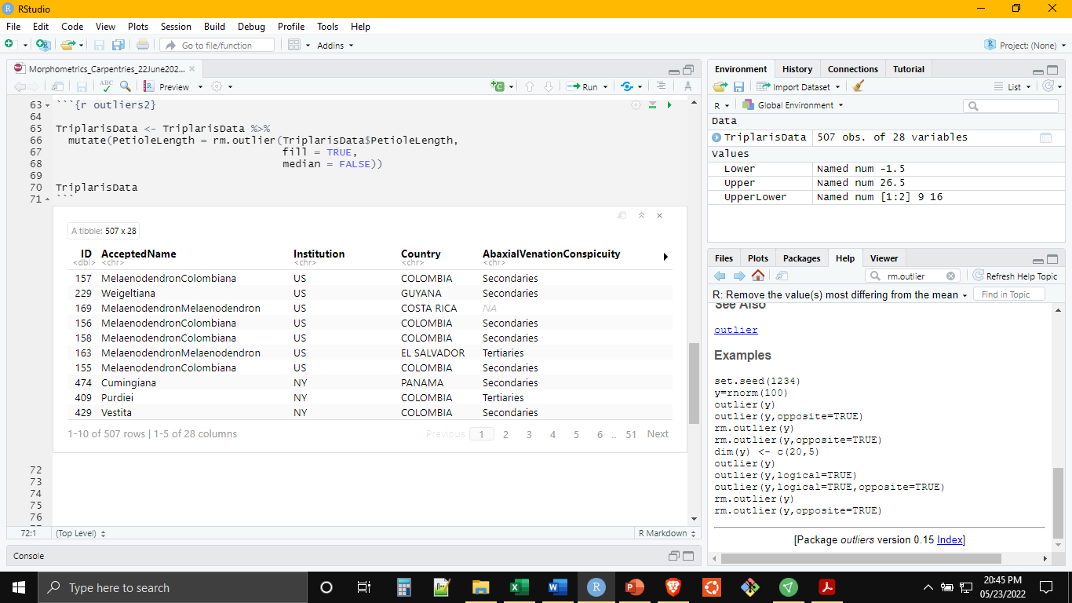
An Introduction to Morphometrics in R
Outliers
Some Data Scientists Get Really, Really Triggered by Removing Outliers
At the Same Time, Some Analyses Are Influenced by Outliers (PCA, Mixture Modeling)

Slide 8
An Introduction to Morphometrics in R
Missing Data
Missing Data is also a Major Problem in Some Analysis Methods (PCA): Remove or Impute
Notes:
What are factors and why do we care

Slide 9
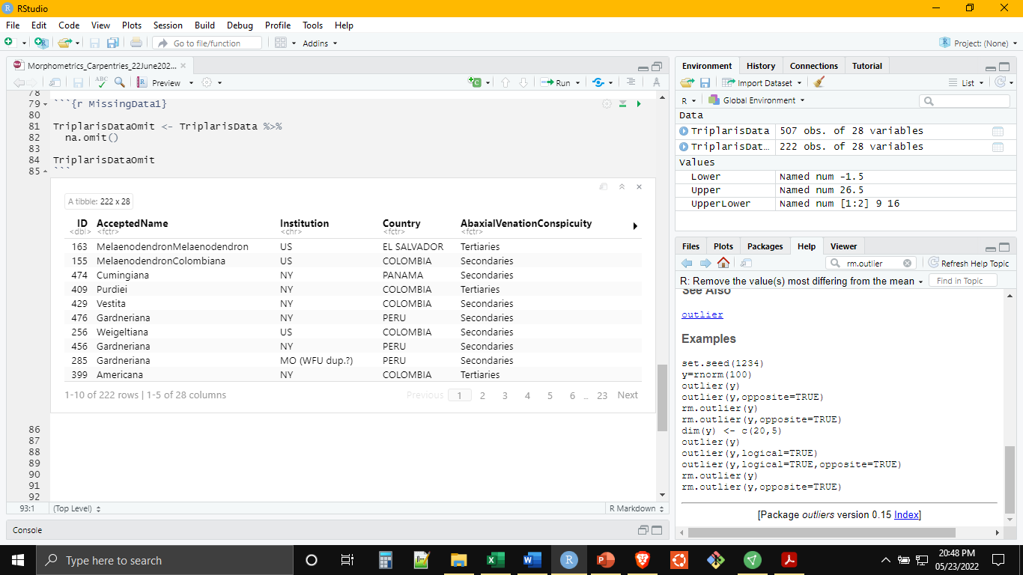
An Introduction to Morphometrics in R
Missing Data: Omit
Removing Missing Data Can Be Costly: 507x28 to 222x28
Notes:
What are factors and why do we care

Slide 10
An Introduction to Morphometrics in R
Missing Data: Imputation/Interpolation
Some Notes on Imputation/Interpolation
Completing Dataset Without Changing Statistical Properties
A Simple Imputation is to Supply the Mean for Missing Values
Strong Opinions: Some Statisticians Consider it Fabrication
Imputation Must be Tailored to Analysis Method (and its Assumptions)
Dray, S and J Josse. 2015. Principal component analysis with missing values: a comparative survey of methods. Plant Ecology 216: 657-667. https://doi.org/10.1007/s11258-014-0406-z.
missMDA
Imputation for PCA: Preserves the Magnitude and Direction of Eigen Vectors
Notes:
What are factors and why do we care

Slide 11
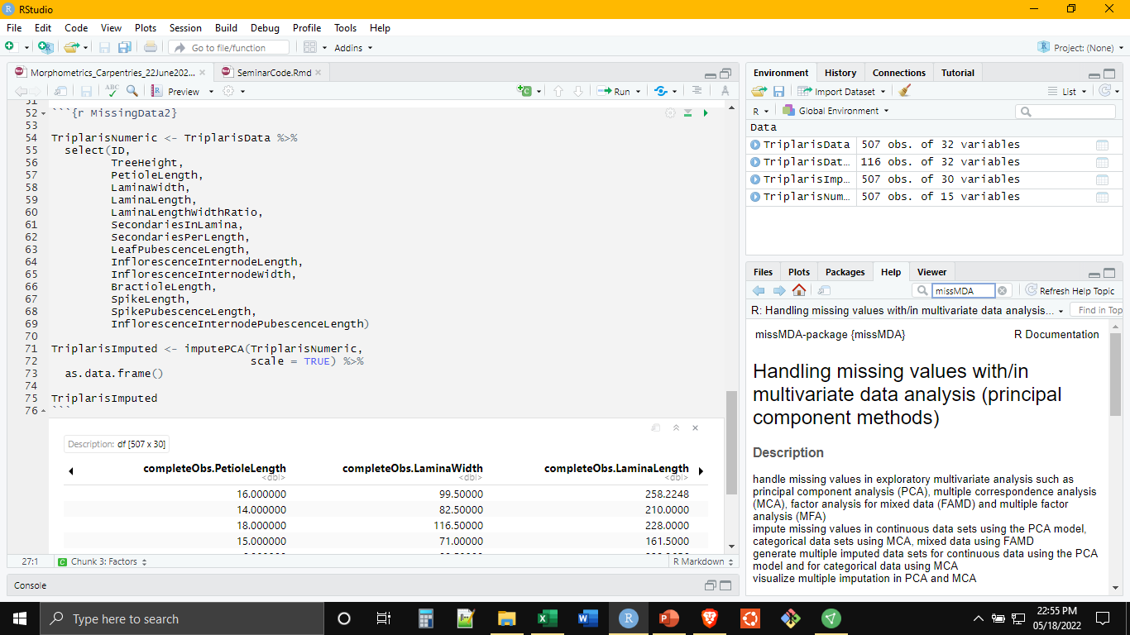
An Introduction to Morphometrics in R
Missing Data: Imputation/Interpolation
Imputed Values May Not Be Biologically/Anthropologically/Economically Meaningful (Negative)

Slide 12
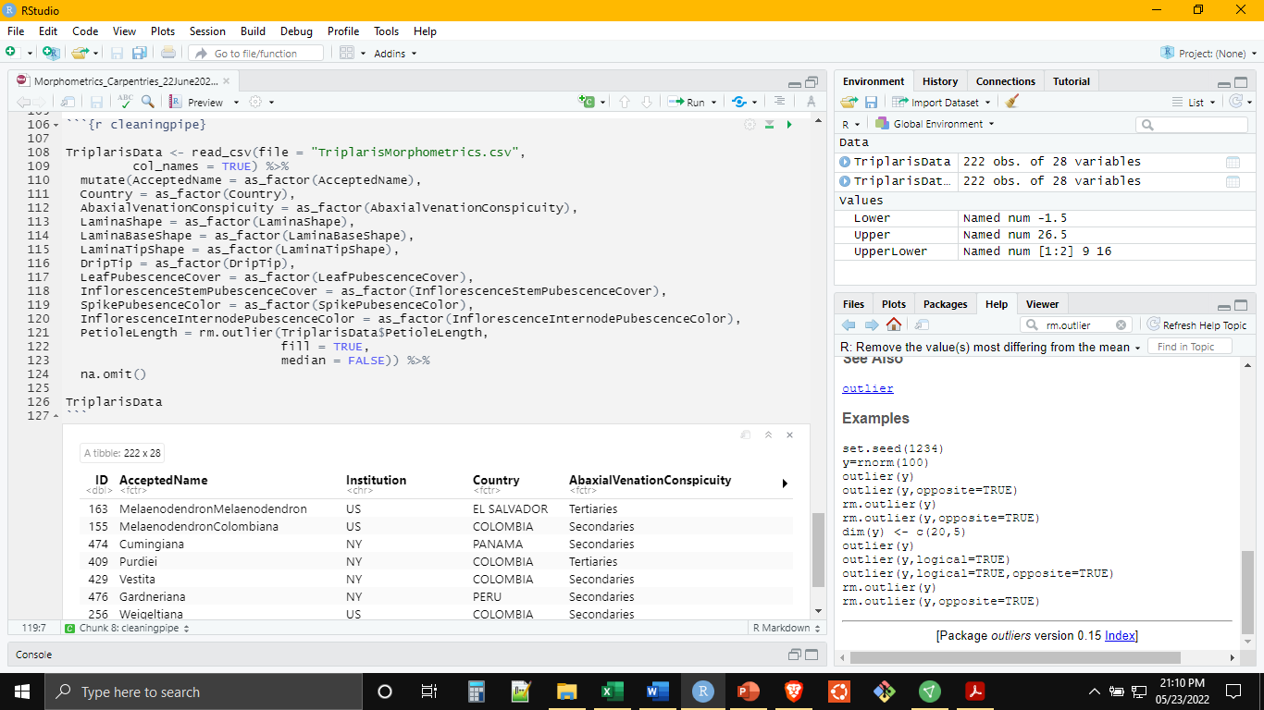
An Introduction to Morphometrics in R
Streamlining With the Pipe %>%
All or Mostly All of Our Cleaning Can Be Done At Once (magrittr)

Slide 13
Exploratory Data Analysis
PCA
Normal Mixture Modeling
Hierarchical Clustering
Notes:
What methods are available for what data?
Numeric data (including shape traces) with nothing missing: PCA, Normal (Gaussian) Mixture Modeling
Mixed data (complete or some missing): Hierarchical Clustering

Slide 14
An Introduction to Morphometrics in R
Principal Component Analysis (PCA)
Using the variation present in a collection of variables, generates a new set of variables that are uncorrelated and which retain as much of the original variation as possible. “Dimension reduction” allows for easier visualization/comprehension of the variation in complex datasets.
For Numerical Datasets with Few Outliers and No Missing Data

Slide 15
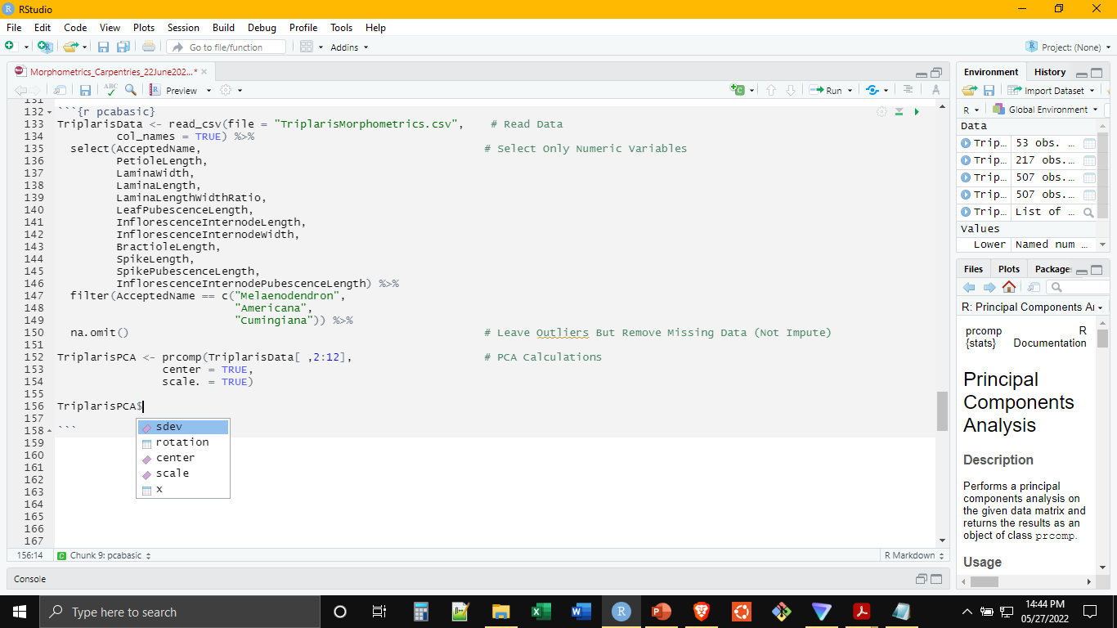
An Introduction to Morphometrics in R
PCA: For Numerical Datasets with Few Outliers and No Missing Data
Create an PCA Object with prcomp() (‘stats’ Package) and display results with ggplot()
Notes:
Using native r functions affords flexibility, also more specificity in analysis conditions
Usually also allows for more customization in visualization at the end, can move into ggplot
Using packages may be easier and require less proficiency in r
Generally less specificity in analysis conditions (sometimes this better and helps you avoid mistakes)
Generally few options for visualization at the end
Many projects may result in the cobbling together of some of both

Slide 16
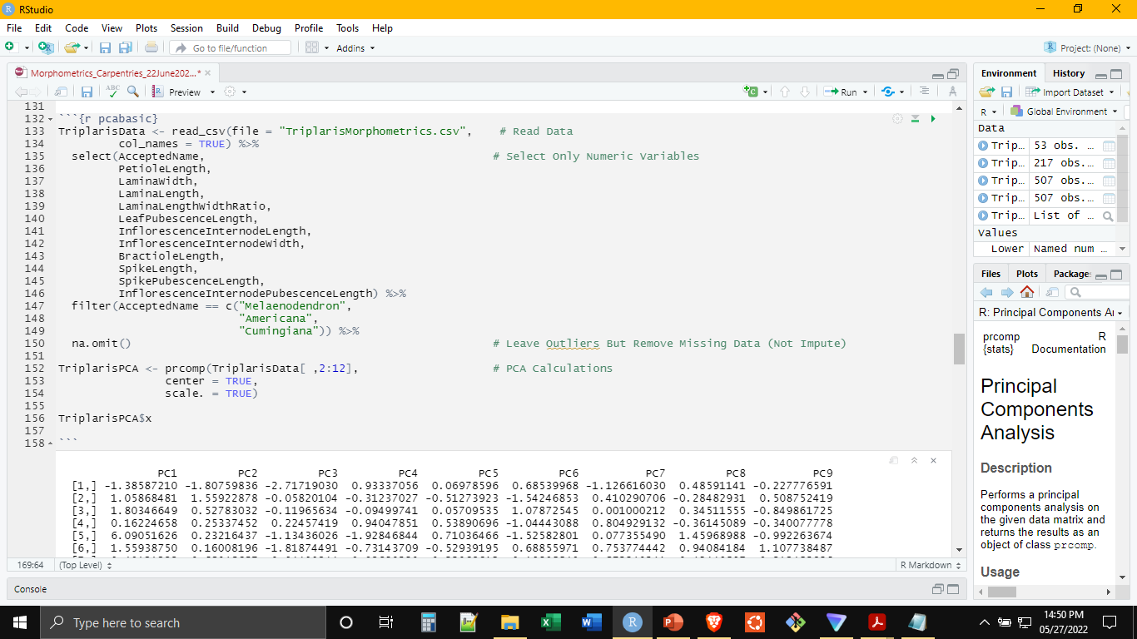
An Introduction to Morphometrics in R
PCA: For Numerical Datasets with Few Outliers and No Missing Data
Create an PCA Object with prcomp() (‘stats’ Package) and display results with ggplot()

Slide 17
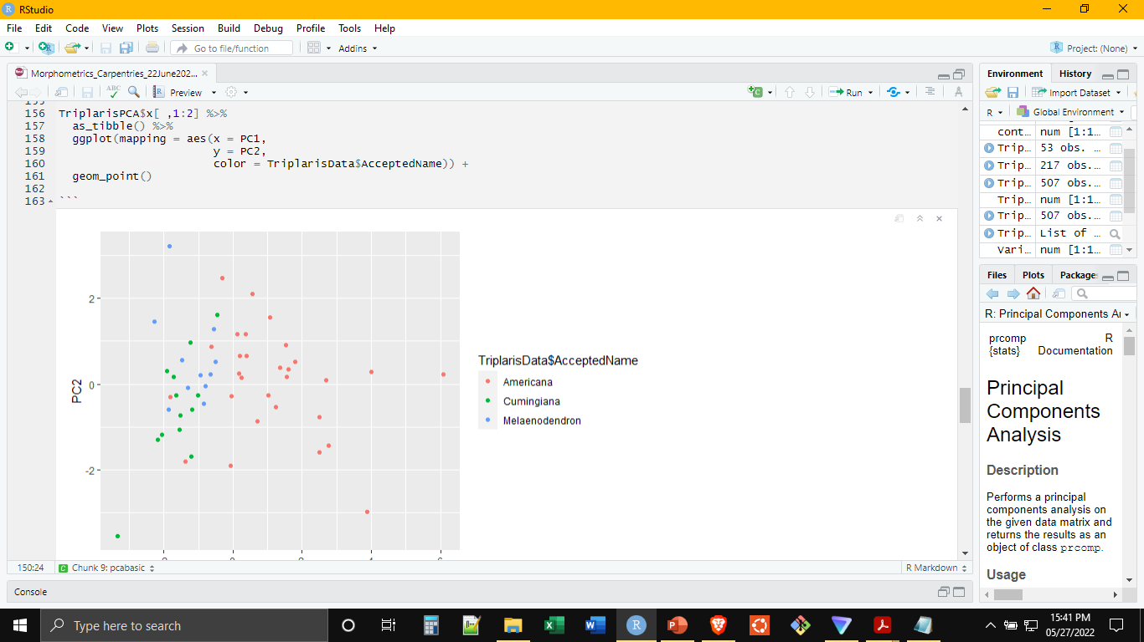
An Introduction to Morphometrics in R
PCA: For Numerical Datasets with Few Outliers and No Missing Data
Create an PCA Object with prcomp() (‘stats’ Package) and display results with ggplot()

Slide 18
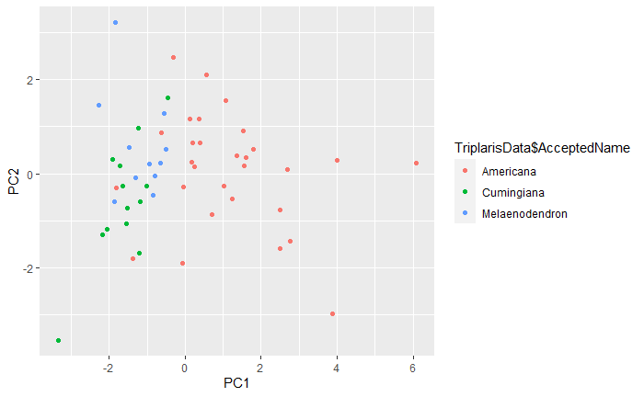
An Introduction to Morphometrics in R
PCA: For Numerical Datasets with Few Outliers and No Missing Data
Create an PCA Object with prcomp() (‘stats’ Package) and display results with ggplot()

Slide 19
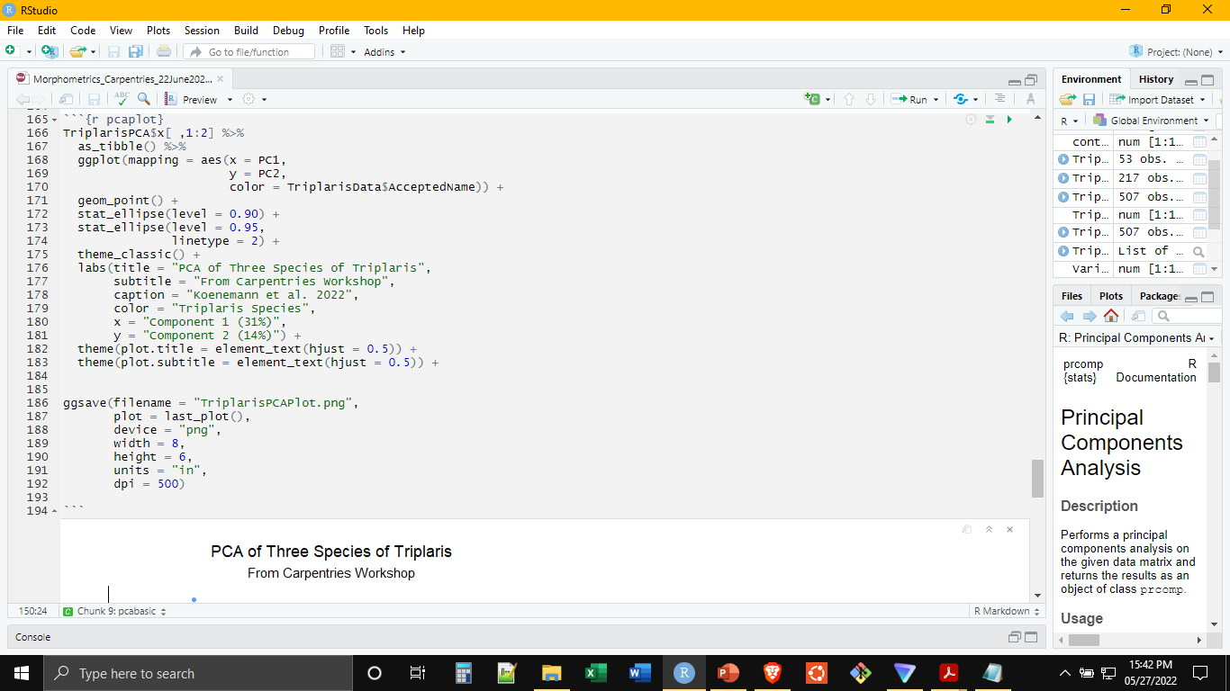
An Introduction to Morphometrics in R
PCA: For Numerical Datasets with Few Outliers and No Missing Data
ggplot() Provides a Variety of Ways to Modify and Save the Plot

Slide 20
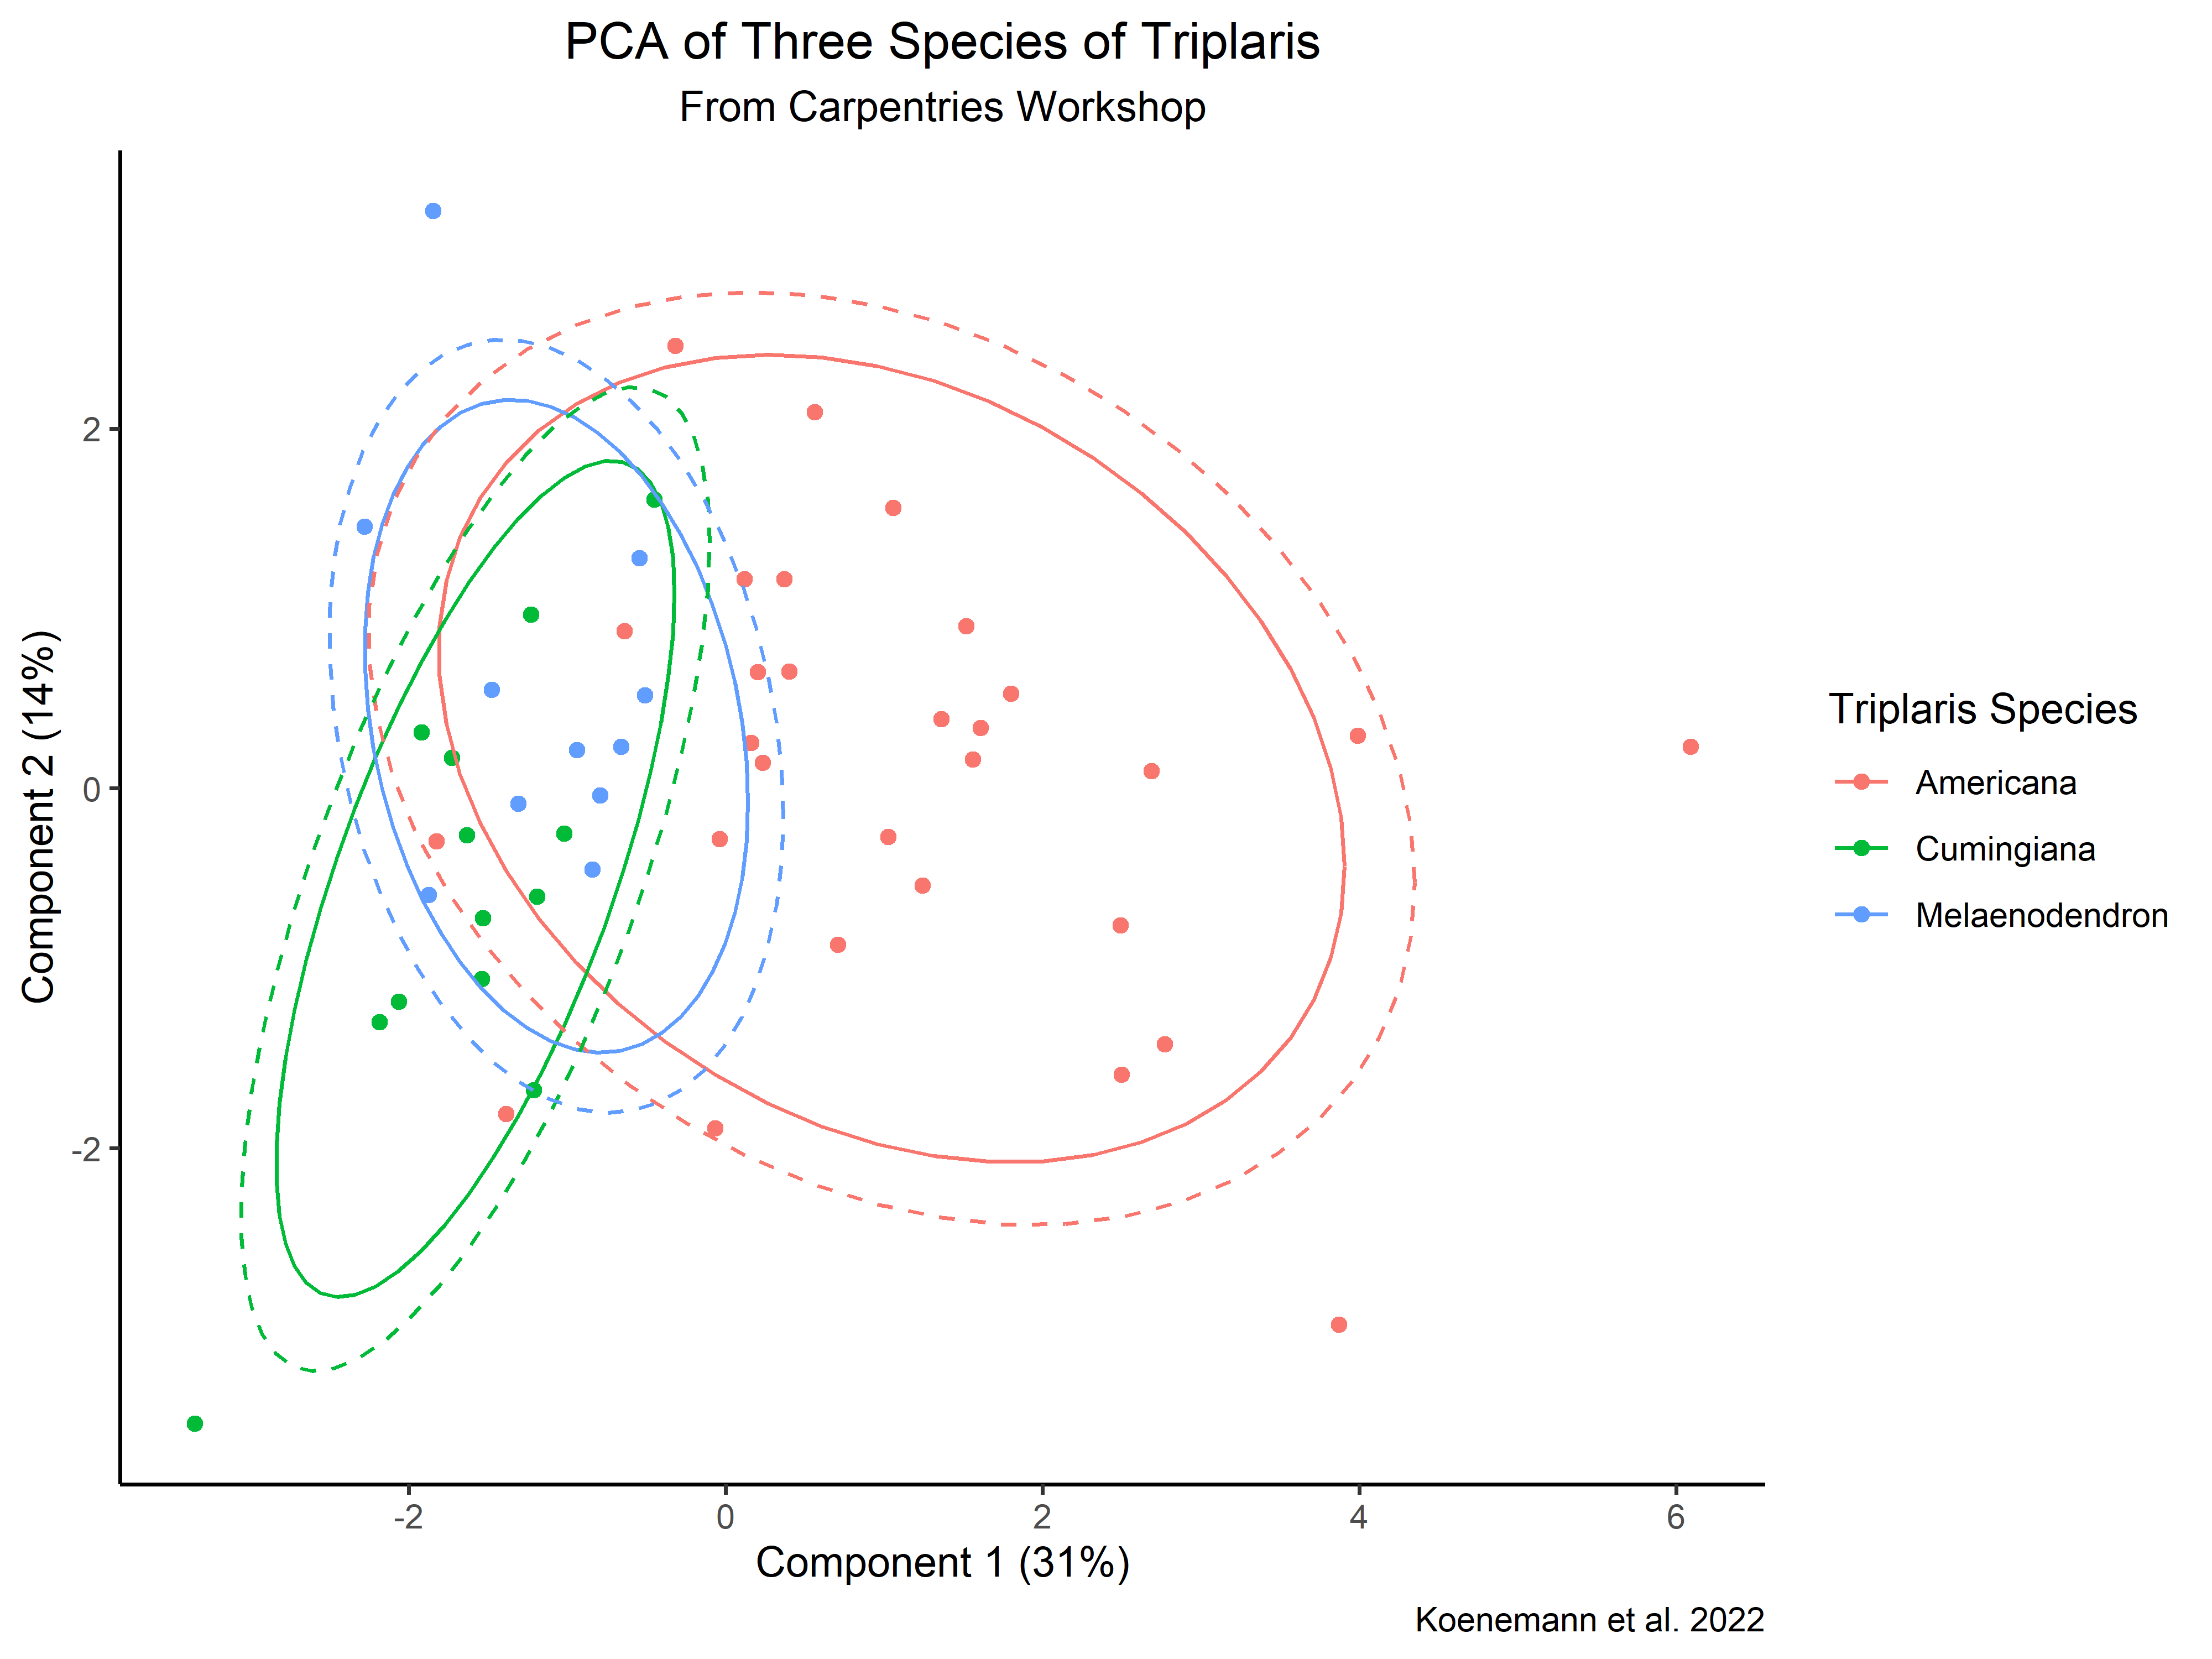
An Introduction to Morphometrics in R
PCA: For Numerical Datasets with Few Outliers and No Missing Data
ggplot() Provides a Variety of Ways to Modify and Save the Plot

Slide 21
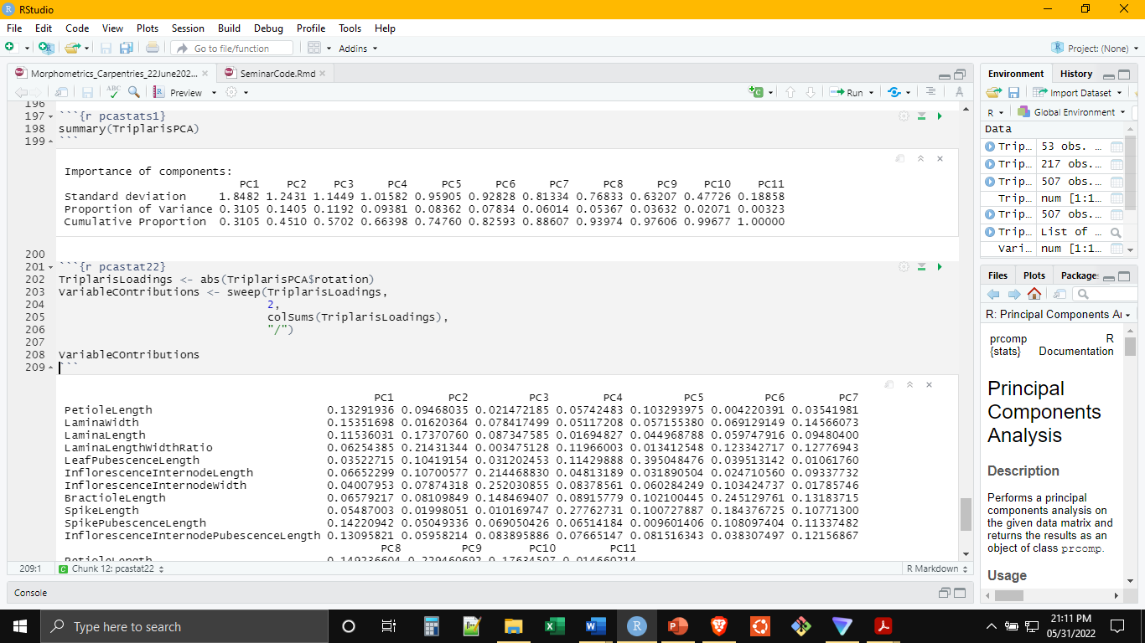
An Introduction to Morphometrics in R
PCA: For Numerical Datasets with Few Outliers and No Missing Data
The Complex TriplarisPCA Object also Includes Basic Statistics About the Analysis

Slide 22
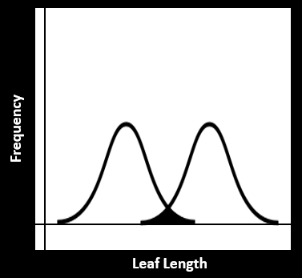
An Introduction to Morphometrics in R
Normal “Gaussian” Mixture Modeling
Uses the properties of the normal distribution to discriminate groups.
For Numerical Datasets with Few Outliers and No Missing Data, Assumes Data Normally Distributed

Slide 23
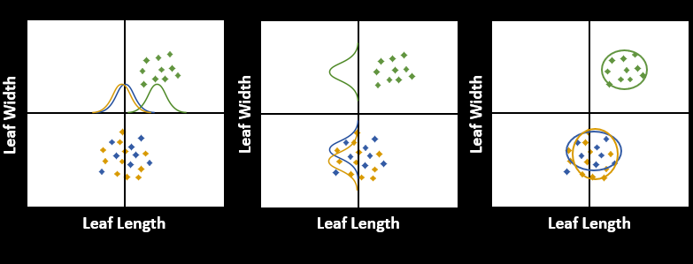
An Introduction to Morphometrics in R
Normal “Gaussian” Mixture Modeling
Uses the properties of the normal distribution to discriminate groups.
For Numerical Datasets with Few Outliers and No Missing Data, Assumes Data Normally Distributed

Slide 24
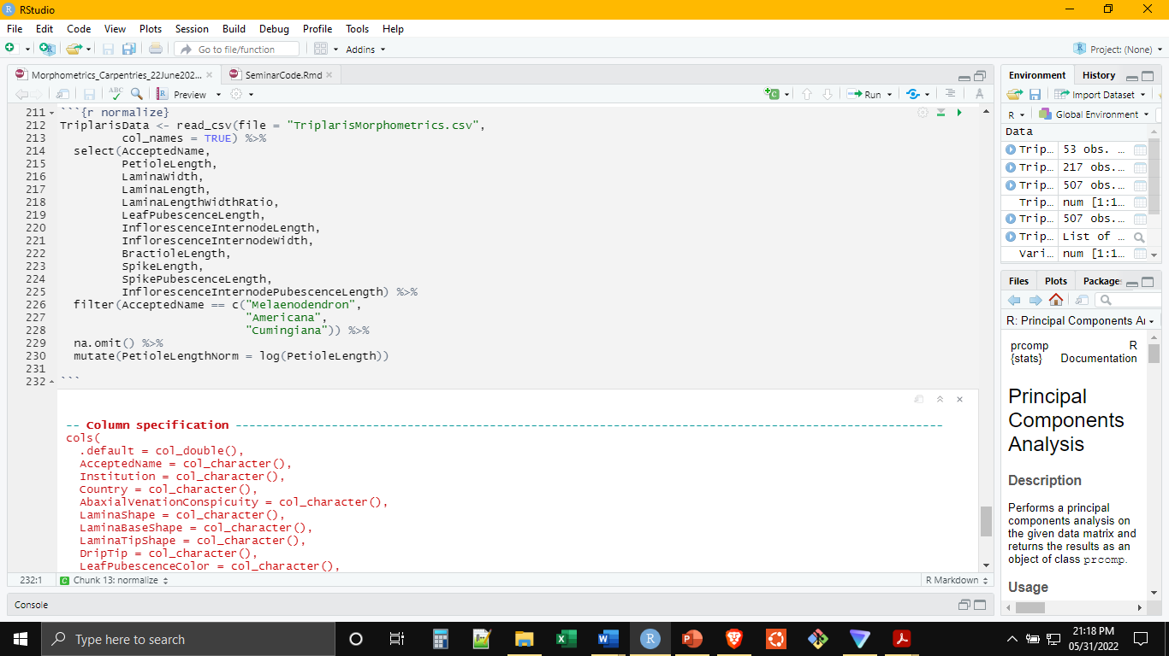
An Introduction to Morphometrics in R
Normal Mixture Modeling
Will Need to Clean, Deal with Missing Data Here Also (Thinking of the Mean)
Since This Method Relies On the Normal Distribution, Variables May Need Transformation

Slide 25
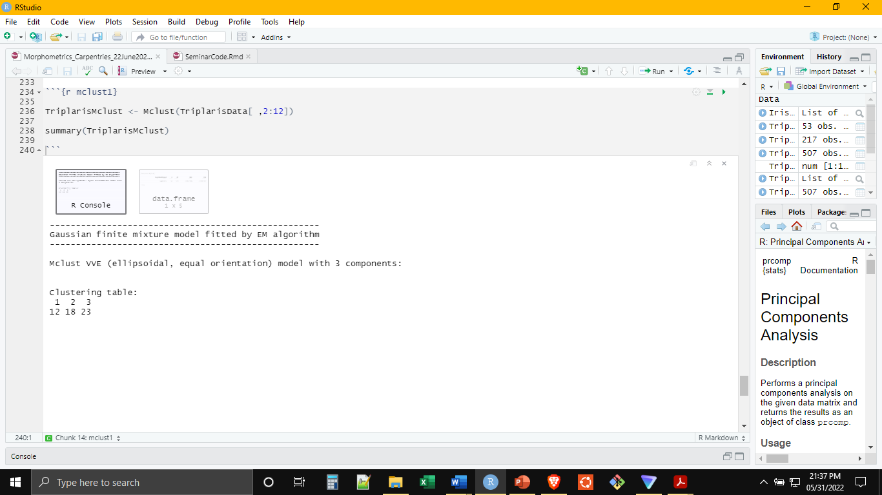
An Introduction to Morphometrics in R
Normal Mixture Modeling
Conducting the Analysis is Reasonably Straightforward (‘mclust’ Package)

Slide 26
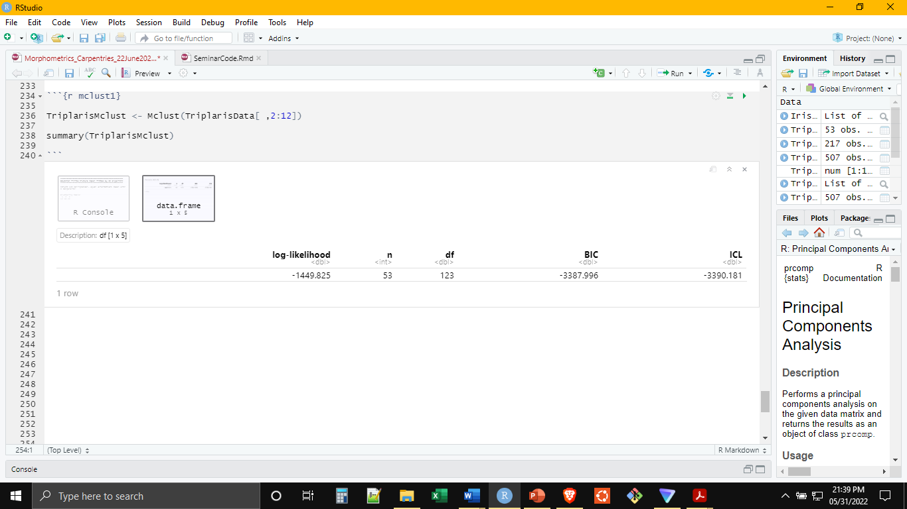
An Introduction to Morphometrics in R
Normal Mixture Modeling
Conducting the Analysis is Reasonably Straightforward (‘mclust’ Package)

Slide 27
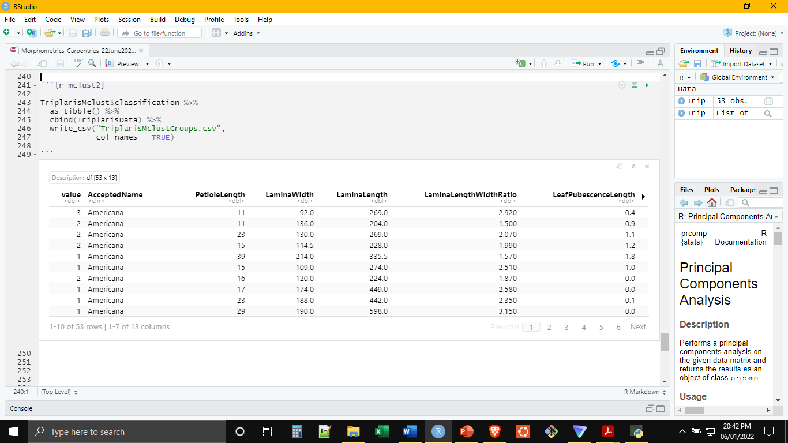
An Introduction to Morphometrics in R
Normal Mixture Modeling
The Group Assignments Can Be Exported and Attached to the Original Dataset using cbind()

Slide 28
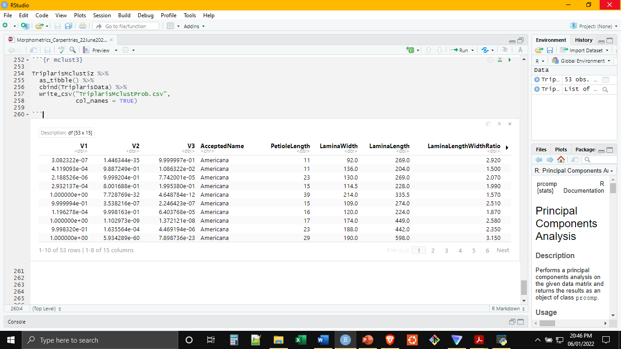
An Introduction to Morphometrics in R
Normal Mixture Modeling
The Same Can Be Done with the Likelihood Scores
Notes:
There is a lot you can do in mclust, including using Bayesian approaches by imputing prior information (group assignments from current taxonomy for example). Mclust has a good manual available that is easy to find online

Slide 29
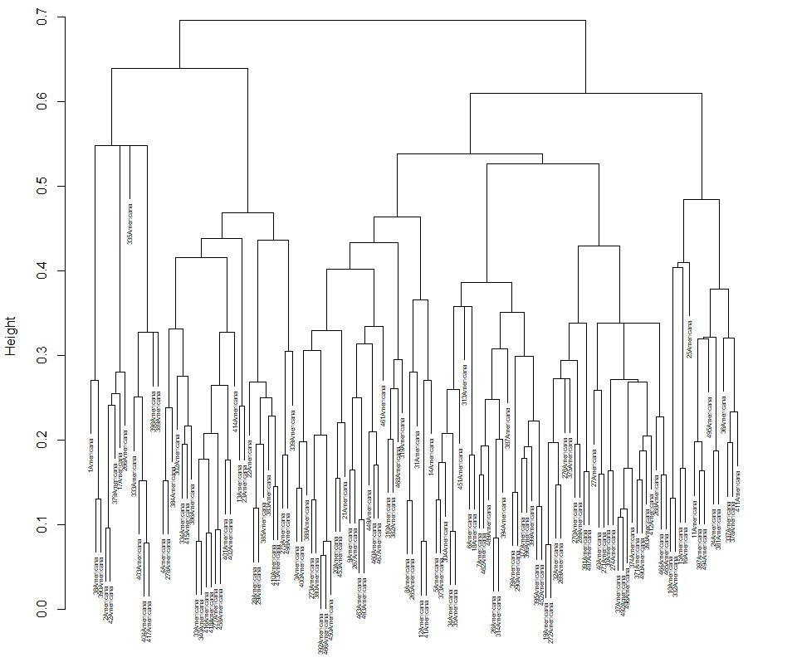
An Introduction to Morphometrics in R
Hierarchical Clustering
K-Means Grouping By Dendrogram
For Mixed Datasets, from Unknown Distributions, with Non-Systematic Missing Data

Slide 30
An Introduction to Morphometrics in R
Numeric Variable Distances
Categorical Variable Distances
Height | Obs 1 | Obs 2 | Obs 3 | Obs 4 | Obs 5 | Obs 6 | Obs n
Obs 1 | 0 | 2 | 4.5 | 1 | 8 | 1.5 | …
Obs 2 | - | 0 | 7 | 0.5 | 4.2 | 3 | …
Obs 3 | - | - | 0 | 12 | 4 | 13 | …
Obs 4 | - | - | - | 0 | 2.75 | 3.5 | …
Obs 5 | - | - | - | - | 0 | 15 | …
Obs 6 | - | - | - | - | - | 0 | …
Obs n | - | - | - | - | - | - | 0
Color | Obs 1 | Obs 2 | Obs 3 | Obs 4 | Obs 5 | Obs 6 | Obs n
Obs 1 | 0 | 0 | 1 | 1 | 1 | 1 | …
Obs 2 | - | 0 | 1 | 0 | 0 | 0 | …
Obs 3 | - | - | 0 | 1 | 0 | 0 | …
Obs 4 | - | - | - | 0 | 1 | 1 | …
Obs 5 | - | - | - | - | 0 | 1 | …
Obs 6 | - | - | - | - | - | 0 | …
Obs n | - | - | - | - | - | - | 0
Scale
Composite Distance Matrix (Gower)
 | Obs 1 | Obs 2 | Obs 3 | Obs 4 | Obs 5 | Obs 6 | Obs n
Obs 1 | 0 | 0.375 | 0.1 | 0.2 | 0.275 | 0.45 | …
Obs 2 | - | 0 | 0.5 | 1.275 | 0.25 | 1.5 | …
Obs 3 | - | - | 0 | 0.9 | 0.75 | 1.75 | …
Obs 4 | - | - | - | 0 | 0.625 | 0.8 | …
Obs 5 | - | - | - | - | 0 | 0.75 | …
Obs 6 | - | - | - | - | - | 0 | …
Obs n | - | - | - | - | - | - | 0

Slide 31
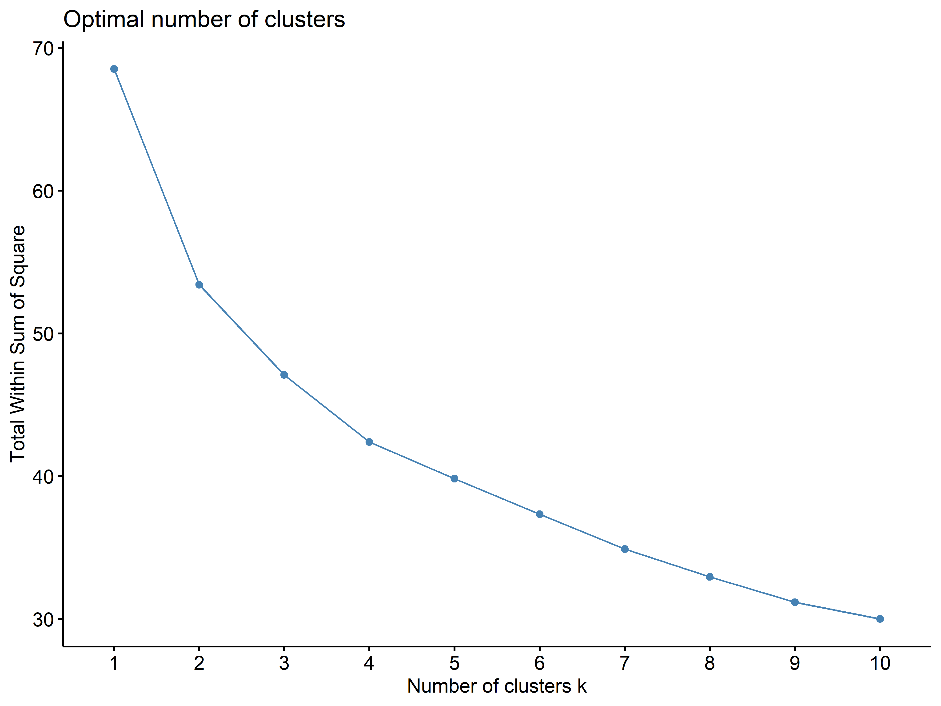
An Introduction to Morphometrics in R
K = 2

Slide 32
An Introduction to Morphometrics in R
K = 2

Slide 33
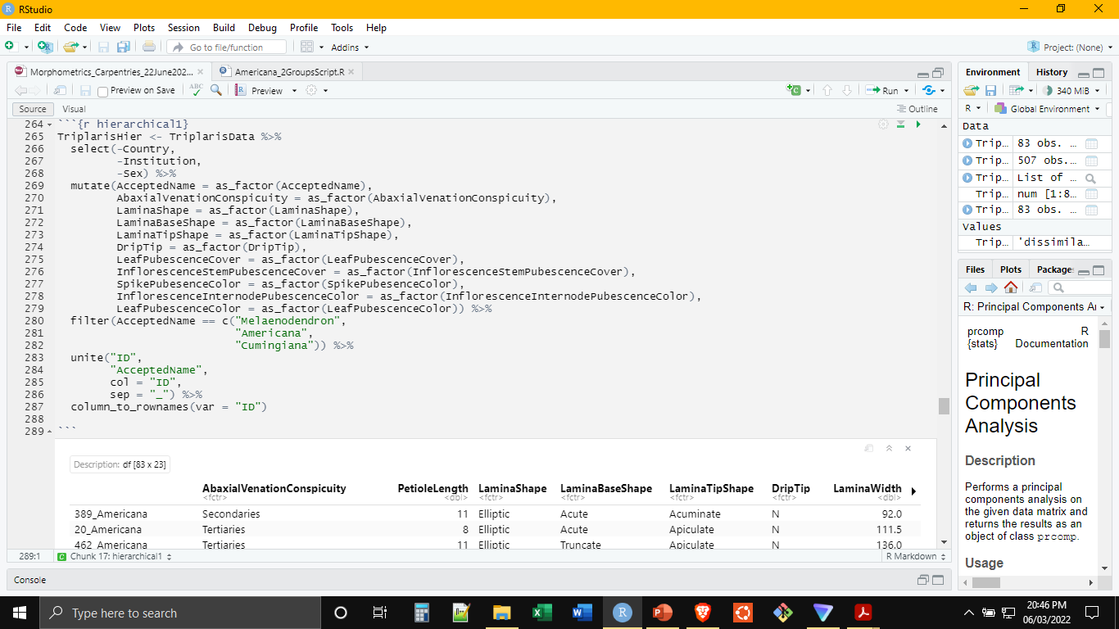
An Introduction to Morphometrics in R
Hierarchical Clustering
Prep the Data, Include Numerical and Categorical, No Need to Remove Missing Data

Slide 34
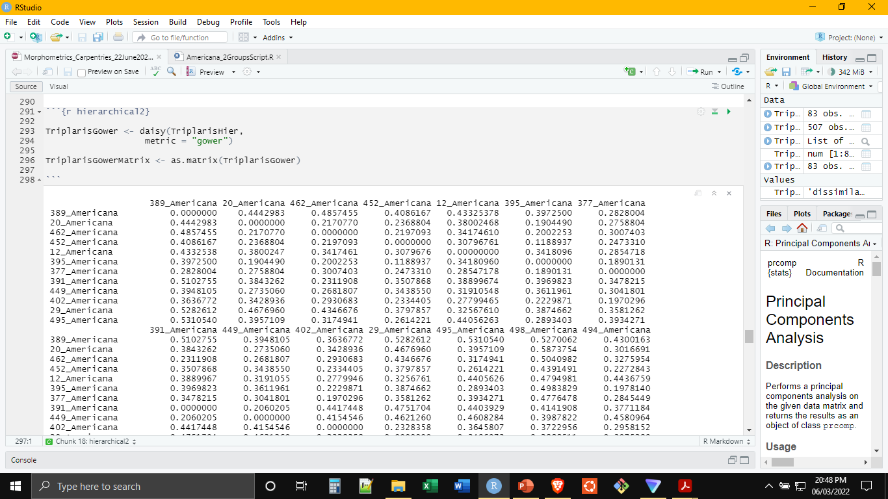
An Introduction to Morphometrics in R
Hierarchical Clustering
The daisy() Function (‘cluster’ Package) Generates the Gower Distance Matrix
Notes:
Daisy can also generate a Euclidian distance matrix using the proper option
If non numeric variables are present, Gower will be selected automatically

Slide 35
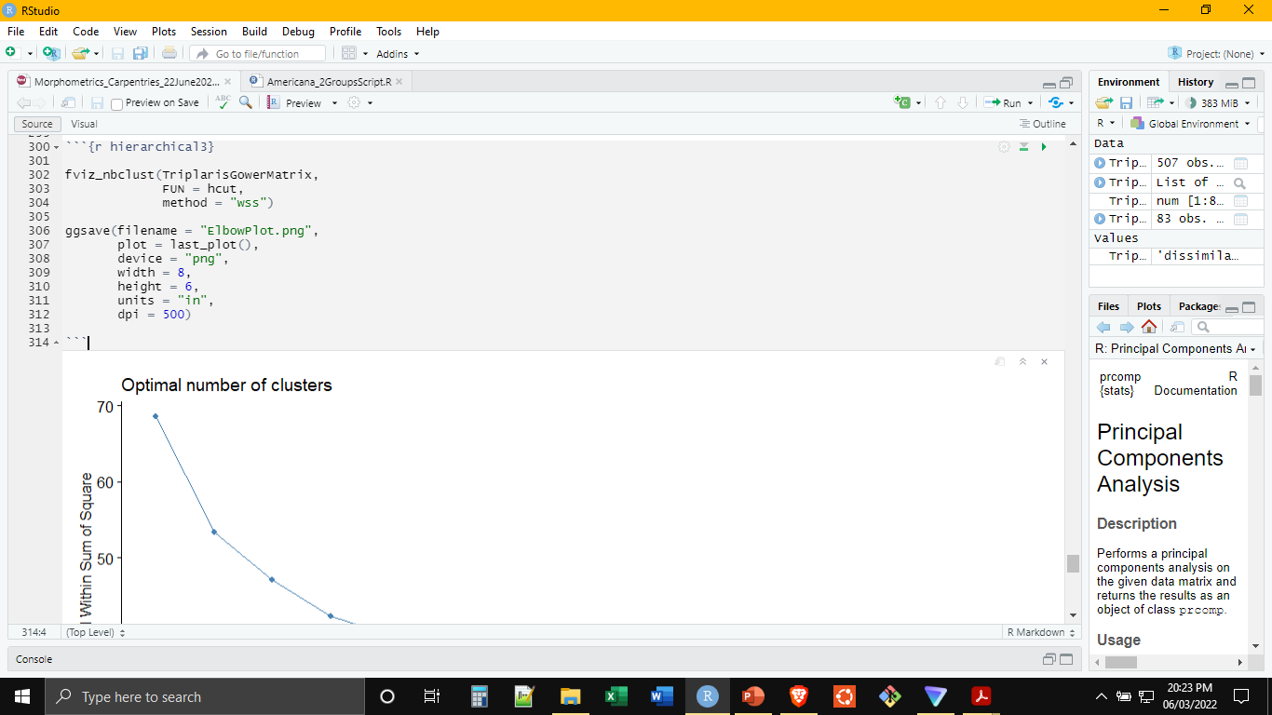
An Introduction to Morphometrics in R
Hierarchical Clustering
The fviz_nbclust() Function (‘factoextra’ Package) Generates the Elbow Plot

Slide 36
An Introduction to Morphometrics in R
Hierarchical Clustering
The fviz_nbclust() Function (‘factoextra’ Package) Generates the Elbow Plot

Slide 37
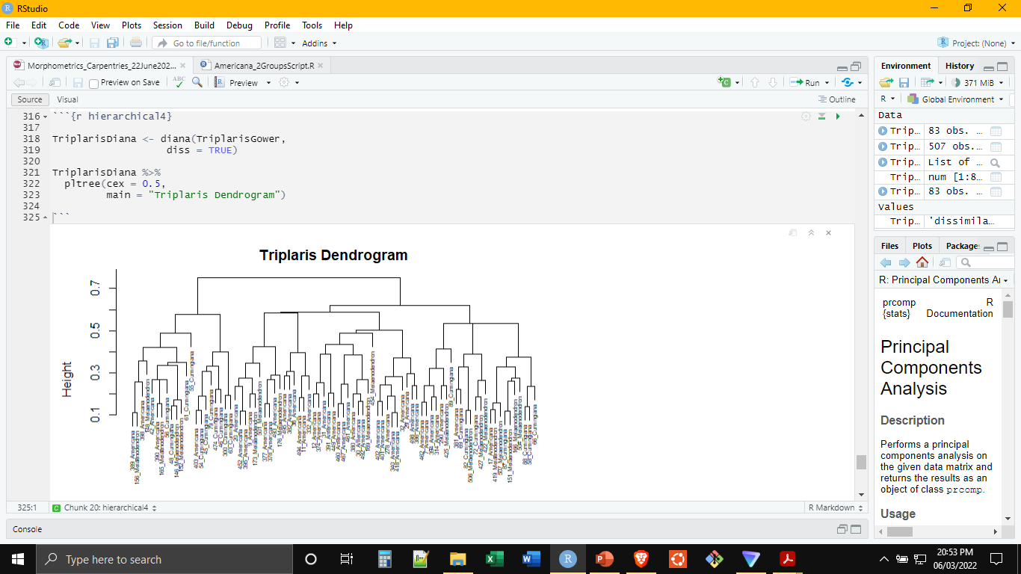
An Introduction to Morphometrics in R
Hierarchical Clustering
The Functions diana() or agnes() (‘cluster’ Package) Are Used to Perform the Clustering

Slide 38
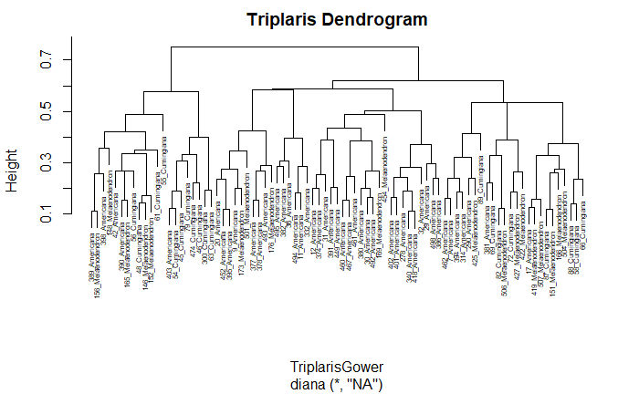
An Introduction to Morphometrics in R
Hierarchical Clustering
The Functions diana() or agnes() (‘cluster’ Package) Are Used to Perform the Clustering

Slide 39
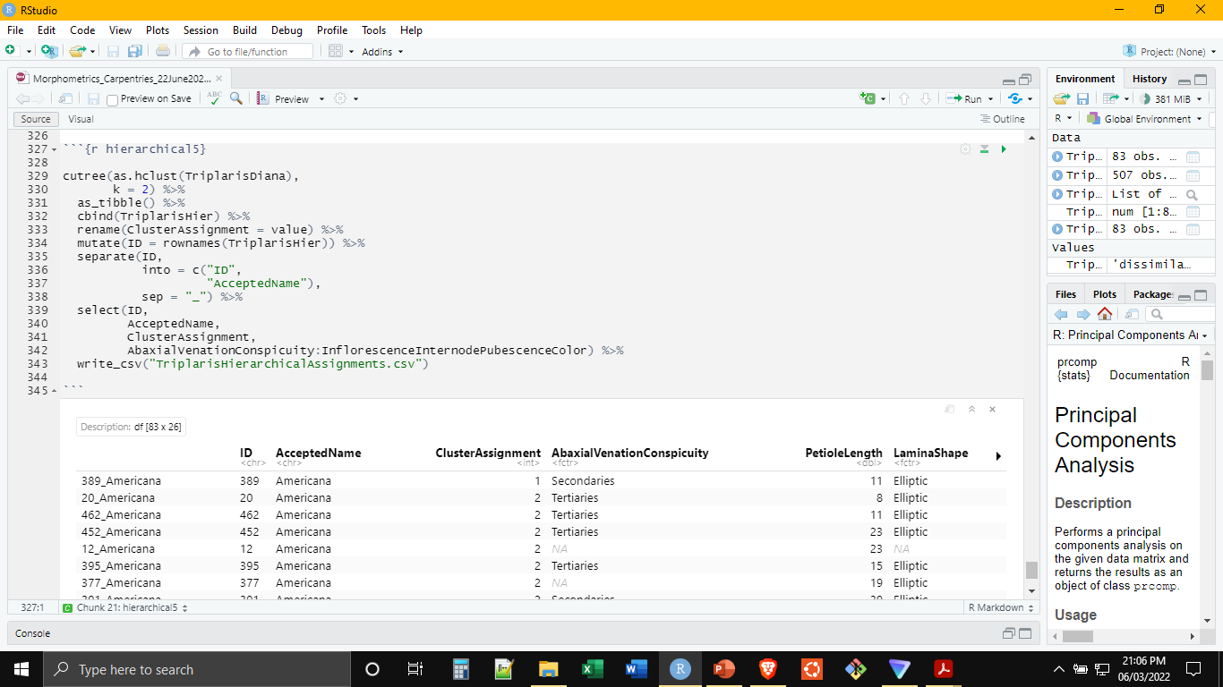
An Introduction to Morphometrics in R
Hierarchical Clustering
The cutree() Function (‘stats’ Package) Is Used to Generate the Clustering Assignments

Slide 40
Thank You!

